Slide 1
Cancer Screening Who, When and How
Hailan Liu, PA-C, PhD
Fox Chase Cancer Center

Slide 3
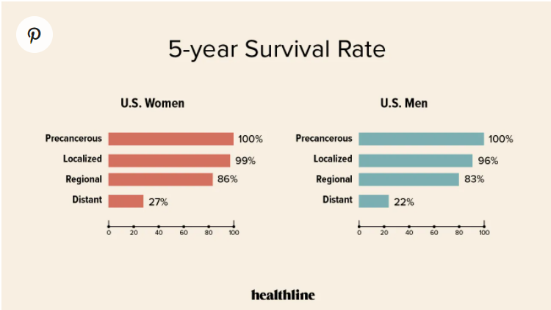
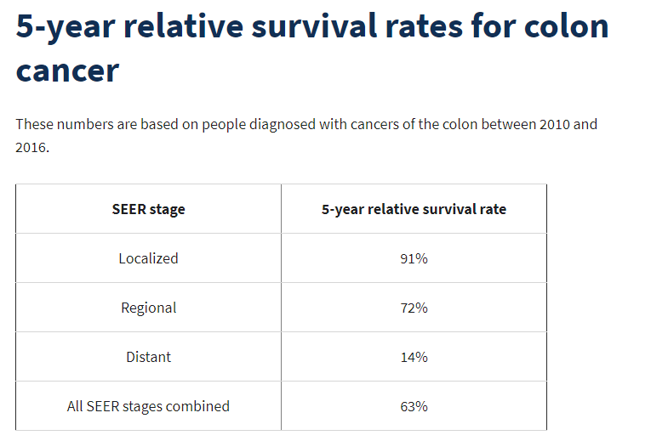
Early Detection Saves Lives
Decrease cancer mortality
Overall cancer mortality has decreased by 25% from 1990 to 2015 in the United States, which can be attributed to greater awareness of cancer screening in the general population.
Less treatment required

Slide 4
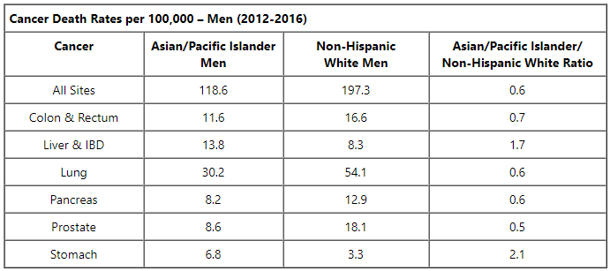
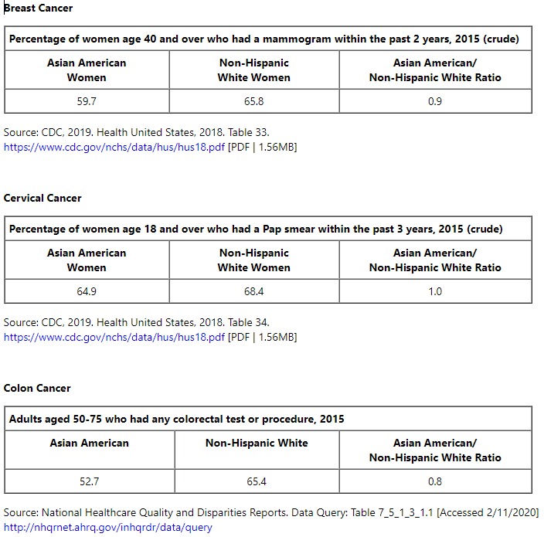
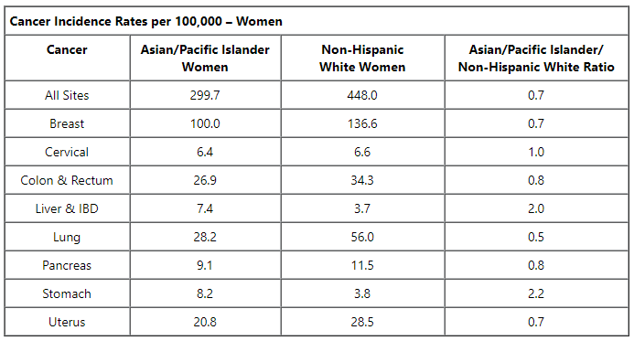
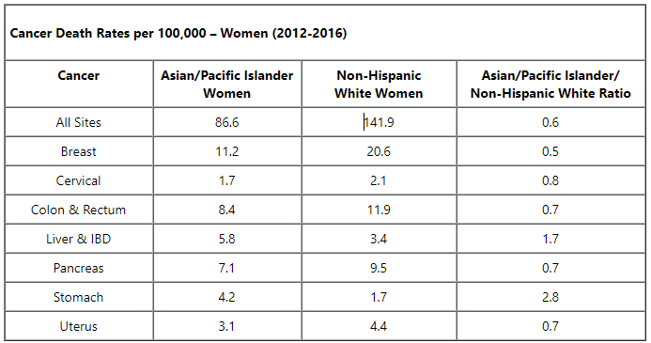
Difference in Cancer Risk and Screening of Asian American
Cancer Incidence
Cancer Death Rate
Cancer Screening
https://minorityhealth.hhs.gov/omh/browse.aspx?lvl=4&lvlid=46
Notes:
https://minorityhealth.hhs.gov/omh/browse.aspx?lvl=4&lvlid=46
Asian American cancer statistics from HHS

Slide 5
Effective Cancer Screening Method
“ Cancer Screening Package”
Blood tests
Cancer markers: not diagnostic
There are blood tests being studied for cancer screening， but none has been fully developed for clinical use yet.
Imaging Studies: not useful for screening general population
USPSTF (United States Preventive Services Taskforce)
For general population → routine screening recommendation
High risk group → comprehensive family history and special screening guideline and method

Slide 6
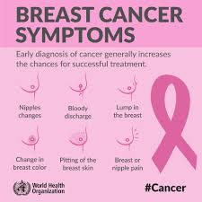
Breast Cancer
Most common cancer in female
13% life time risk ( 1 in 8 )
2nd leading cause of cancer death in women
Risk Factors: age, family hx, genetic risk (BRCA genes), race, dense breast, early menstrual start, late menopause, hx of radiation to chest, overweight/obese, not physically active, not having children, not breast feeding, birth control, hormone therapy after menopause
Risk calculators available online

Slide 7
Breast Cancer
Mammogram: the best way to find breast cancer early
40-49
Discuss with your healthcare professional about risk and benefit
Discussion with your healthcare professional
75 and older
50-74
Average risk
Every 2 years
High Risk Population: Should be followed by specialist for proper screening

Slide 8
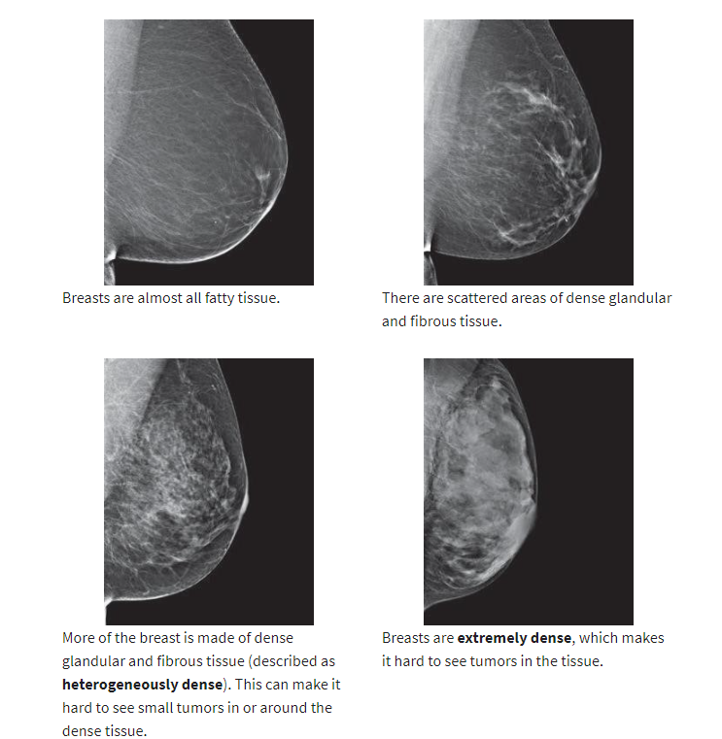
Dense breast:
3D mammogram
breast US and MRI: 1. your insurance might not cover it; 2. more findings that may leads to more testing and biopsies that can do harm
There’s not enough evidence to make a recommendation for or against yearly MRI screening for women who have a higher lifetime risk based on certain factors, such as:
Having a personal history of breast cancer, ductal carcinoma in situ (DCIS), lobular carcinoma in situ (LCIS), atypical ductal hyperplasia (ADH), or atypical lobular hyperplasia (ALH)
Having “extremely” or “heterogeneously” dense breasts as seen on a mammogram

Slide 9
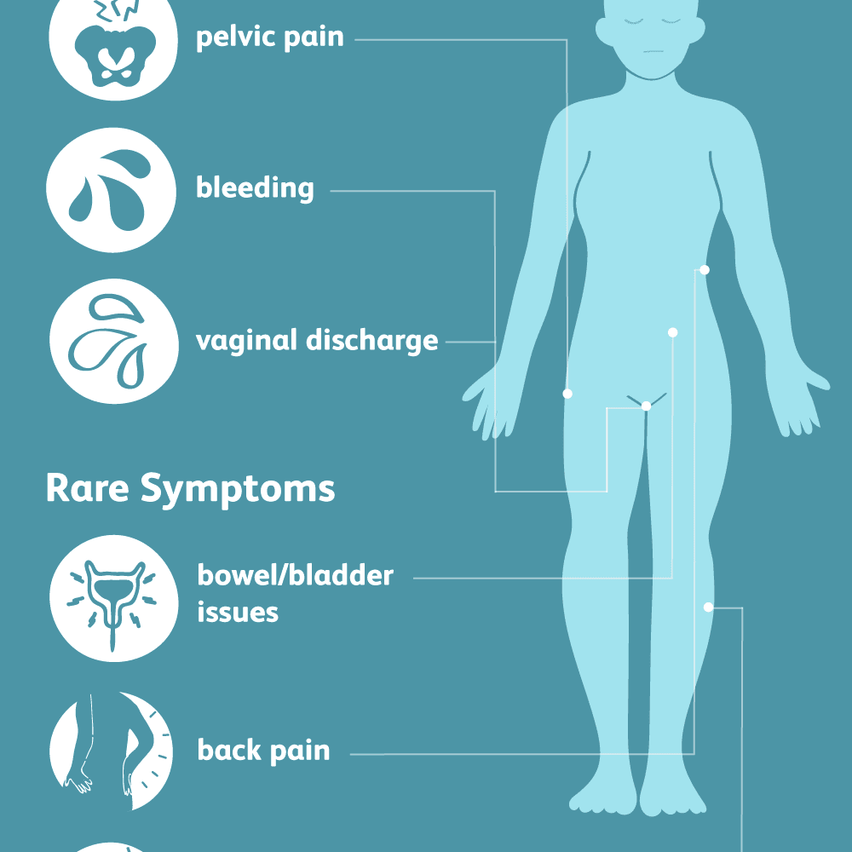
Cervical Cancer
Pre-cancers are diagnosed far more often than invasive cervical cancer.
Rate dropped significantly with the increased use of pap smear.
Risk Factor:
HPV infection
Sexual history, smoking, weakened immune system, STD, long term use of oral contraceptive, family history, etc.

Slide 10
Cervical Cancer Screening
Pap smear and HPV test
21-29
Pap smear every 3 years
No HPV testing
30-65
Pap only: every 3 years
HPV test only: every 5 years
65 and older
No more screening if you have had normal screening test for several years or you had cervix removed for non-cancerous condition.
Should still see you gynecologist as directed
Co-testing: 5 years

Slide 11
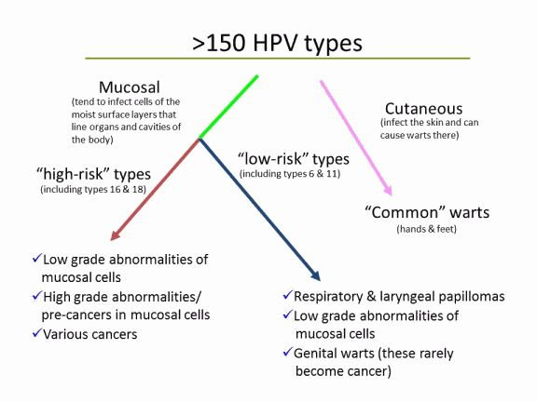
HPV and HPV Vaccine
HPV spread through sexual contact mainly.
Can cause genital warts and cancer (cervical , vulvar, penile, anal, oropharyngeal cancer etc)
High risk HPV: 16 and 18
HPV vaccine: Gardasil 9 (16, 18, 31, 33, 45, 52, 58)
Recommended age: 9-14 yo recommended, up to 45 yo in certain situation.

Slide 12
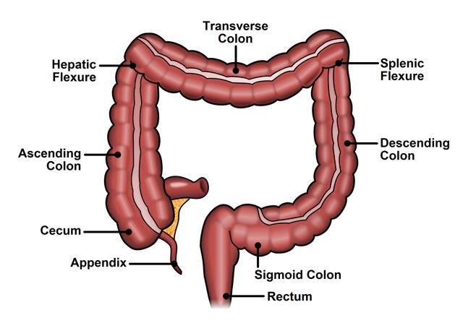
Colorectal Cancer
3rd most commonly diagnosed cancer (1 in 23 risk in men and 1 in 25 for women)
2nd leading cause of cancer death
Young onset (people under 55) is still on the rise
Overall lower rate of CRC screening in Asian Americans.
Risk Factors: age, family hx, personal hx of polyps, IBD, inherited syndrome, obesity, diet, smoking, alcohol use, etc)

Slide 13
Colorectal Cancer Screening
When
How
45-75
routine screening recommended
76-85
individual decision after discussion with your health care provider
Stool based test
FOBT or FIT YEARLY → detect occult blood in your stool
Stool DNA test: ColoGuard every 3 years
Direct visualization test
Colonoscopy: every 5-10 years
Virtual Colonoscopy: every 5 years
Flexible Sigmoidoscopy: every 5 years
Colonoscopy: can remove polyps during direct visualization. The ultimate test

Slide 14
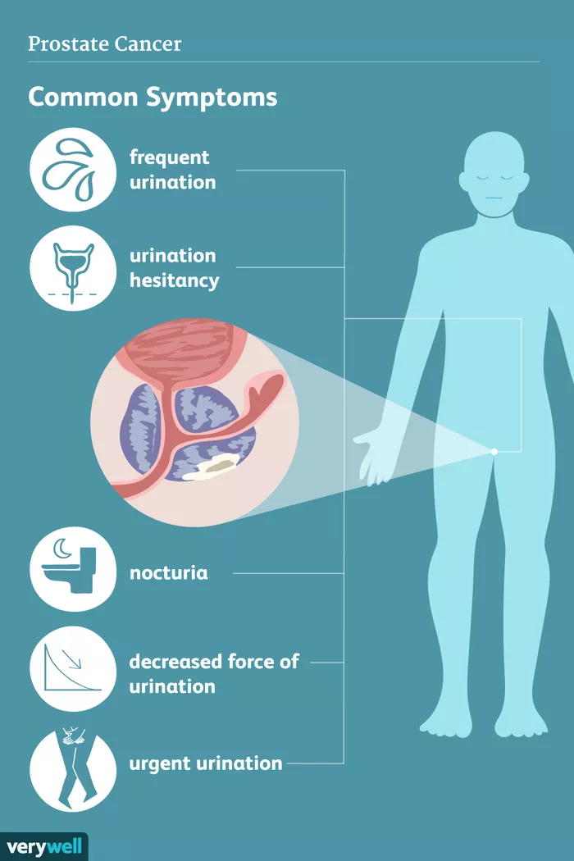
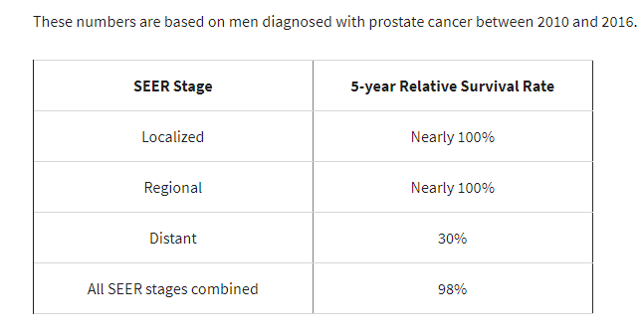
Prostate Cancer
Most common cancer in male
1 in 8 life time risk
2nd leading cause of cancer death in man
Average diagnosis around 66 yo
Many has indolent disease
Risk factor: age, family hx, some genetic factors, obesity, smoking, chemical exposure, STD, etc.

Slide 15
Prostate Cancer Screening
Most controversial between USPSTF and professional organizations.
When
How: Digital prostate exam, PSA
45-75
the decision to be screened for prostate cancer should be an individual one after discussion with your healthcare provider
75 and older
No screening needed

Slide 16
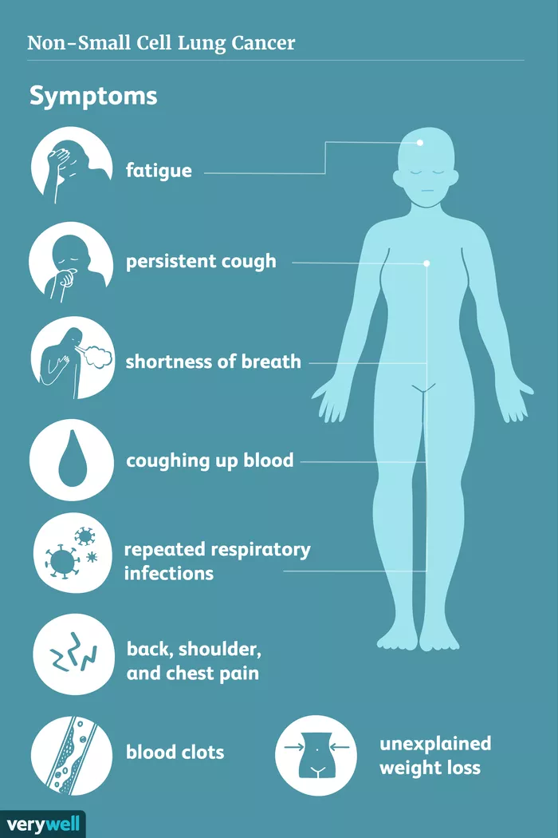
Lung Cancer
2nd most common cancer in both men (1 in 15 life time risk) and women (1 in 17 life time risk)
Mainly occurs in people 65 yo and older
Leading cause of cancer death (25% cancer death)
Risk Factor
Smoking and Secondhand smoke
Exposure to radon, asbestos, exposure to some chemicals.
Family history

Slide 17
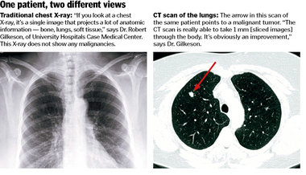
Lung Cancer Screening
WHO: Currently only in selective high-risk population
Current Criteria
55-80 years old
History of heavy smoking (30 pack year)
Current smoker or have quit within the past 15 years
HOW: Annually with low dose CT

Slide 18
Lung Cancer Screening
Never-smoker Asian female: may need to see a specialist (pulmonologist) to discuss if screening is warranted.

Slide 19
Other Cancers
Screening for ovarian, pancreatic, prostate, testicular, and thyroid cancers has not been shown to reduce deaths from those cancers.
The USPSTF found insufficient evidence to assess the balance of benefits and harms of screening for bladder cancer and oral cancer in adults without symptoms, and of visual skin examination by a doctor to screen for skin cancer in adults.

Slide 20
Other Cancers with Higher Incidence in Chinese
Gastric Cancer
H. pylori eradication can significantly reduce the incidence of gastric cancer
Screening with endoscopy
Esophageal cancer
Difference between eastern and western countries (SCC vs adenocarcinoma)
Usually associated with lifestyle factors in China (smoking , drinking, intake of hot liquid)
Liver cancer
Cirrhosis, Hep B, HepC, Aflatoxin
Should follow with a hepatologist if you are high risk.

Slide 21
Establish a good relationship with your PCP (primary care physician/family doctor)

Slide 22
Reference
Cancer.gov (National Cancer Institute – NCI) – NCI designated cancer centers
Cancer.net (ASCO sponsored patient information website)
Cancer.org (American Cancer Society)
NCCN.org (National Comprehensive Cancer Network)
CDC
Many reputable hospitals such as MD Anderson, Mayo clinic, Fox Chase Cancer Center, etc.

